Slide 1


SHRAM SUVIDHA APP 2020

Slide 2
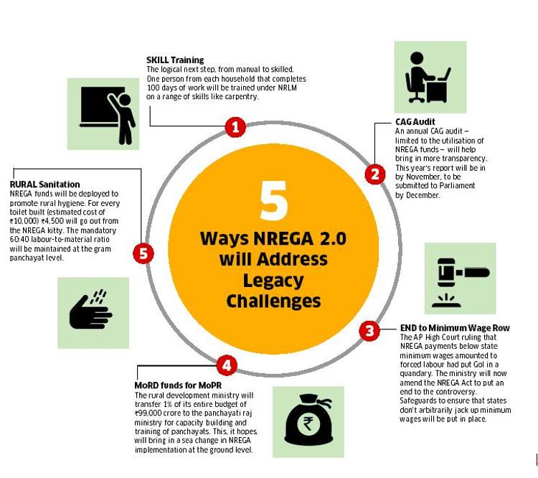

Slide 3
MNREGA
PAYMENTS ARE GIVEN TO WORKERS AFTER THEIR WORK IS COMPLETED.
WAGES ARE GIVEN ACCORDING TO DAY BASIS
100 DAYS ARE CHANGED TO 120 DAYS
The notified wage today varies from a minimum of ₹122 (USD$1.76) in Bihar, Jharkhand to ₹191 (USD$2.76) in Haryana.

Slide 4
PROBLEM SCENERIO AND ANALYSIS:-
THE WORK OF ATTENDANCE IS CUMBERSOME AS IT IS MANUAL AND TAKES A LOT OF TIME
FAULTY MIS(MANAGEMENT INFORMATION SYSTEM) DATA.
THERE IS AN UNORGANISED SYSTEM AND NO PROPER TRACKING OF ATTENDANCE IS DONE

Slide 5
OBJECTIVE:-
TRANSPARENCY
FEASIBLE AND LESS COMPLEX IN RELATION
PREFERRED WITH MINIMAL MANUAL INTERVENTION
MORE RELIABLE AND FRAUDULANT PROOF

Slide 6
KEY FEATURES:-
2. JOINING AND LEAVING ATTENDANCE WILL BE TWO TIMES USING FACE RECOGNITION HOSTED IN MICROSOFT AZURE/GOOGLE FIREBASE.
3. WAGES ARE DIVIDED ON THE BASIS OF TRAININGAND PERMANENT WORK PHASE
4.APP AVAILABLE ON BOTH IOS/ANDROID(IF CREATED IF CREATED IN FLUTTER) ONLY IN A SINGLE CODE BASE.
5. THREE STEP PROCESSES FOR THE REGISTRATION PROCESS FOR MNREGA WORKERS.
1. REGISTRATION PAGE FOR ADMIN/CONTRACTORUSING AADHAR CARD AND AUTHENTICATION IS DONE USING THE FINGER PRINT.

